Slide 1
Final Project
Christine Dewi, 10714904
Maria Böckl, 10714301

Slide 2
Weather Application

Slide 3
Content
Weather application
Stock market

Slide 4
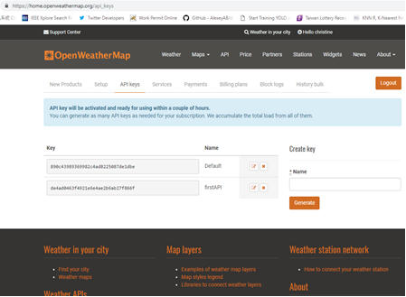
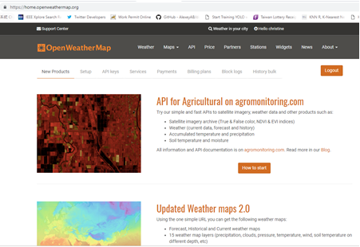
Getting the API
Use open map weather website and register account https://home.openweathermap.org/users/sign_in
Get your API

Slide 5
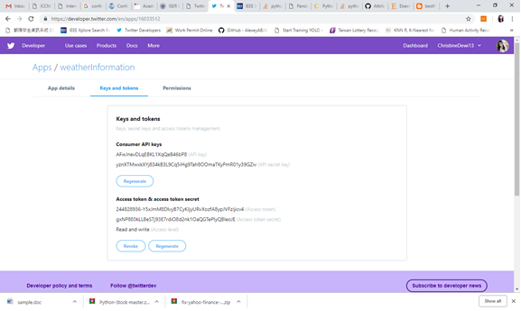
Get Twitter API
Make account for twitter developer from website to get API
https://developer.twitter.com/en/apps

Slide 6
Code (1/7)
# -*- coding: utf-8 -*-
"""
Created on Mon Dec 10 10:13:21 2018
@author: Christine
"""
import datetime
import json
import urllib.request
import tweepy
# Create variables for each key, secret, token
consumer_key = ‘XXXXXXX'
consumer_secret = ‘XXXXXX'
access_token = ‘XXXXXX'
access_token_secret = ‘XXXXXX'

Slide 7
Code (2/7)
# Set up OAuth and integrate with API
auth = tweepy.OAuthHandler(consumer_key, consumer_secret)
auth.set_access_token(access_token, access_token_secret)
api = tweepy.API(auth)
def time_converter(time):
converted_time = datetime.datetime.fromtimestamp(
int(time)
).strftime('%I:%M %p')
return converted_time

Slide 8
Code (3/7)
def url_builder(city_id):
user_api = '890c43989369982c4ad8225087de1dbe' # Obtain yours form: http://openweathermap.org/
unit = 'metric' # For Fahrenheit use imperial, for Celsius use metric, and the default is Kelvin.
api = 'http://api.openweathermap.org/data/2.5/weather?id=' # Search for your city ID here: http://bulk.openweathermap.org/sample/city.list.json.gz
full_api_url = api + str(city_id) + '&mode=json&units=' + unit + '&APPID=' + user_api
return full_api_url
def data_fetch(full_api_url):
url = urllib.request.urlopen(full_api_url)
output = url.read().decode('utf-8')
raw_api_dict = json.loads(output)
url.close()
return raw_api_dict

Slide 9
Code (4/7)
def data_organizer(raw_api_dict):
data = dict(
city=raw_api_dict.get('name'),
country=raw_api_dict.get('sys').get('country'),
temp=raw_api_dict.get('main').get('temp'),
temp_max=raw_api_dict.get('main').get('temp_max'),
temp_min=raw_api_dict.get('main').get('temp_min'),
humidity=raw_api_dict.get('main').get('humidity'),
pressure=raw_api_dict.get('main').get('pressure'),
sky=raw_api_dict['weather'][0]['main'],
sunrise=time_converter(raw_api_dict.get('sys').get('sunrise')),
sunset=time_converter(raw_api_dict.get('sys').get('sunset')),
wind=raw_api_dict.get('wind').get('speed'),
wind_deg=raw_api_dict.get('deg'),
dt=time_converter(raw_api_dict.get('dt')),
cloudiness=raw_api_dict.get('clouds').get('all')
)
return data

Slide 10
Code (5/7)
def data_output(data):
m_symbol = '\xb0' + 'C'
#tweet ='Current weather in :'+data['city'],data['country']+''
#tweet = 'Name : '+user.name+', User Id :'+user.id_str+''
tweet ='Current weather in : {}, {},\nTemperature {} {} {}, \nMax: {}, Min: {}, \nWind Speed: {}, Degree: {}, \nHumidity: {}, \nCloud: {}, \nPressure: {}, \nSunrise at: {}, \nSunset at: {},\nLast update from the server: {}'.format(data['city'], data['country'], data['temp'], m_symbol, data['sky'],data['temp_max'], data['temp_min'],data['wind'], data['wind_deg'],data['humidity'],data['cloudiness'],data['pressure'],data['sunrise'],data['sunset'],data['dt'])
api.update_status(status=tweet)

Slide 11
Code (6/7)
api.update_status(status=tweet)
# print('---------------------------------------')
print('Current weather in: {}, {}:'.format(data['city'], data['country']))
print(data['temp'], m_symbol, data['sky'])
print('Max: {}, Min: {}'.format(data['temp_max'], data['temp_min']))
# print('')
print('Wind Speed: {}, Degree: {}'.format(data['wind'], data['wind_deg']))
print('Humidity: {}'.format(data['humidity']))

Slide 12
Code (7/7)
print('Cloud: {}'.format(data['cloudiness']))
print('Pressure: {}'.format(data['pressure']))
print('Sunrise at: {}'.format(data['sunrise']))
print('Sunset at: {}'.format(data['sunset']))
print('')
print('Last update from the server: {}'.format(data['dt']))
# print('---------------------------------------')
#taiwan id 1668284
#indonesia id 1643084
if __name__ == '__main__':
try:
# Write a tweet to push to our Twitter account
data_output(data_organizer(data_fetch(url_builder(1643084))))
except IOError:
print('no internet')

Slide 13
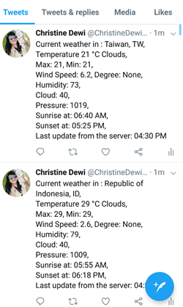
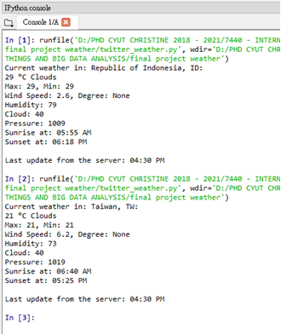
Output

Slide 14

Alternative
Make an IFTTT account
Press new applet under your username
Press the +this
Choose the weather underground service
Select todays weather report
Choose a time
Create trigger

Slide 15

Alternative (2/2)
Press that
Choose your preferred social medium (here twitter)
Choose a suitable tweet format (with or without picture)
Connect with your twitter
Press Finish

Slide 16
Stock market

Slide 17
Assignment
write a program to find the best stock value interest rate during the ten years and return its stroke price at a selected category.

Slide 18
Websites
https://finance.yahoo.com/quote/MSFT/history?period1=1199980800&period2=1515600000&interval=1mo&filter=history&frequency=1mo
https://finance.yahoo.com/quote/GOOG/history?p=GOOG
https://finance.yahoo.com/quote/AAPL/history?p=AAPL
https://finance.yahoo.com/quote/MSFT?p=MSFT

Slide 19
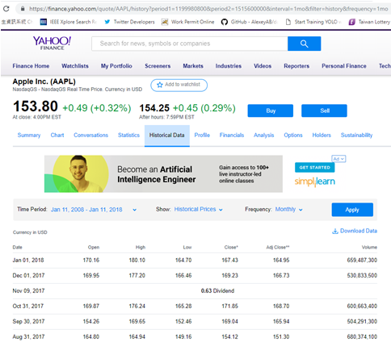
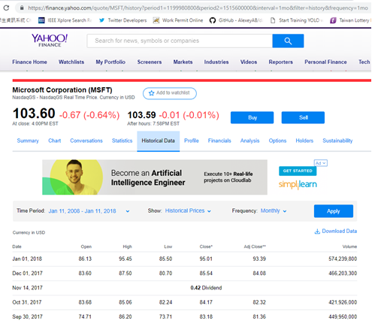
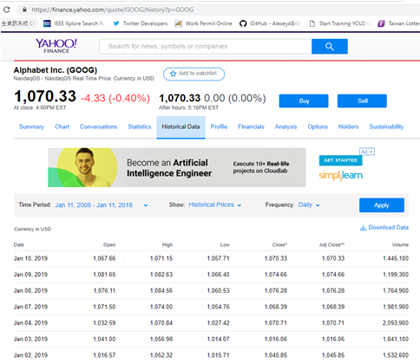
Websites

Slide 20
Code(1/)
from pandas_datareader import data
import datetime as dt
import pandas as pd
ticker = 'GLD'
start = '2008-11-11'
end = '2018-11-11'
#data1 = data.DataReader(ticker,'yahoo',dt.datetime(2014,11,11),dt.datetime(2016,11,11))
#print (data1)
#data1.head()
apple = data.DataReader("AAPL", "yahoo", start, end)
microsoft = data.DataReader("MSFT", "yahoo", start, end)
google = data.DataReader("GOOG", "yahoo", start, end)
stocks1 = pd.DataFrame({"AAPL": apple["High"],
"MSFT": microsoft["High"],
"GOOG": google["High"]})

Slide 21
Code(2/)
#print("HIGH")
#print(stocks1)
stocks1.plot(kind='line', title='HIGH', fontsize=9, figsize=(16,9))
stocks = pd.DataFrame({"AAPL": apple["Adj Close"],
"MSFT": microsoft["Adj Close"],
"GOOG": google["Adj Close"]})
#print("Adj Close")
print(stocks)
stocks1 = pd.DataFrame({"AAPL": apple["High"],
"MSFT": microsoft["High"],
"GOOG": google["High"]})
stocks2 = pd.DataFrame({"AAPL": apple["High"]})
stocks2.plot(kind='line', title='HIGH', fontsize=9, figsize=(16,9))
stocks3 = pd.DataFrame({"MSFT": microsoft["High"]})
stocks3.plot(kind='line', title='HIGH', fontsize=9, figsize=(16,9))
stocks4 = pd.DataFrame({"GOOG": google["High"]})
stocks4.plot(kind='line', title='HIGH', fontsize=9, figsize=(16,9))

Slide 22
Code(3/3)
#print(stocks.head())
import warnings
warnings.simplefilter(action='ignore', category=FutureWarning)
print(stocks.describe())

Slide 23
Output
Day values of Apple, Microsoft and Google
Graphs for each of them and together
Count, mean, std, min max and 25%,50%,75%

Slide 24
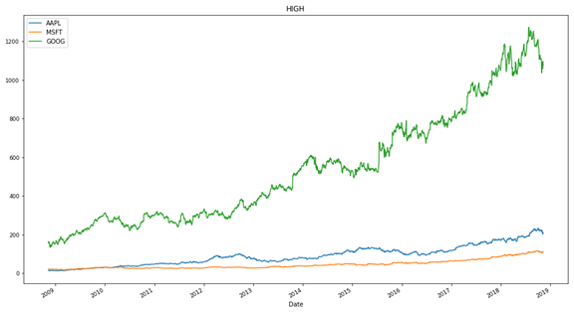
Output

Slide 25
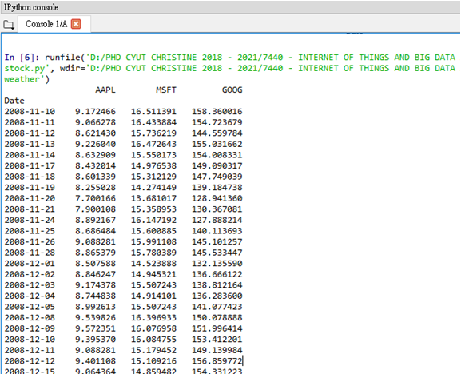
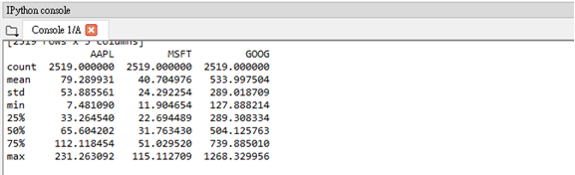
Output

